Slide 1
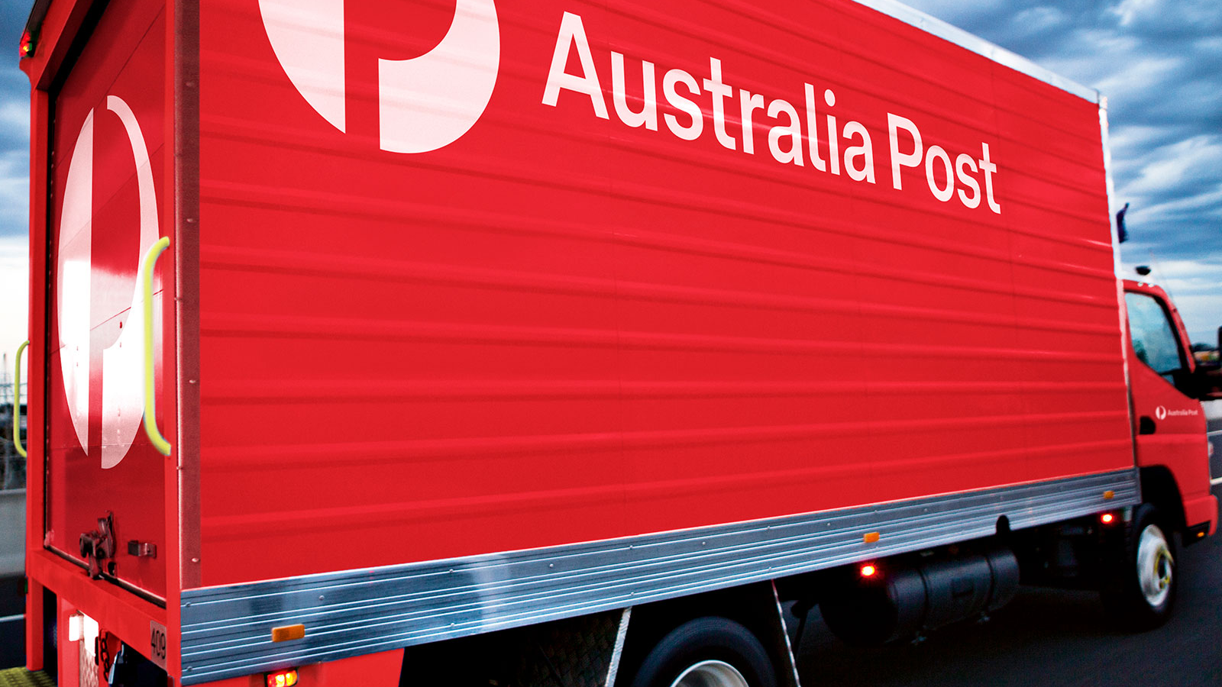


Australia Post Group
Delivering like never before

